Slide 1
MERN(A)
Day 2

Slide 2
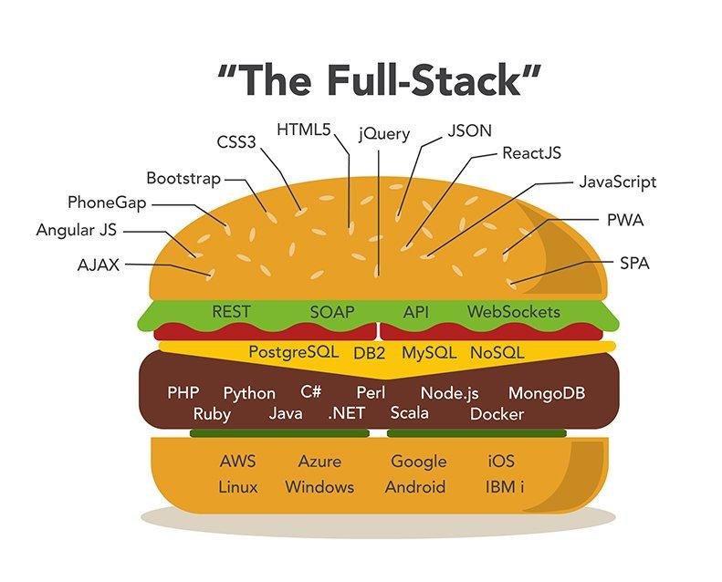
MERN STACK
The MEAN stack is a software stack
The term stack refers to the combination of components and tools that make up the application.
It is a set of the technology layers that make up a modern application that built entirely in JavaScript.

Slide 3

MONGO DB
MongoDB introduced the collection and documentation of the data.
It offers the NoSQL type database.
A database server that is queried using JSON and that stores data structures in a binary JSON format.

Slide 4

NodeJS (back-end runtime environment)
A JavaScript runtime environment
Node is cross-platform, runs on both servers and clients
We use to build server-side applications, but it does not know how to perform serving files, handling requests, and handling HTTP methods, so this is where express js comes in

Slide 5
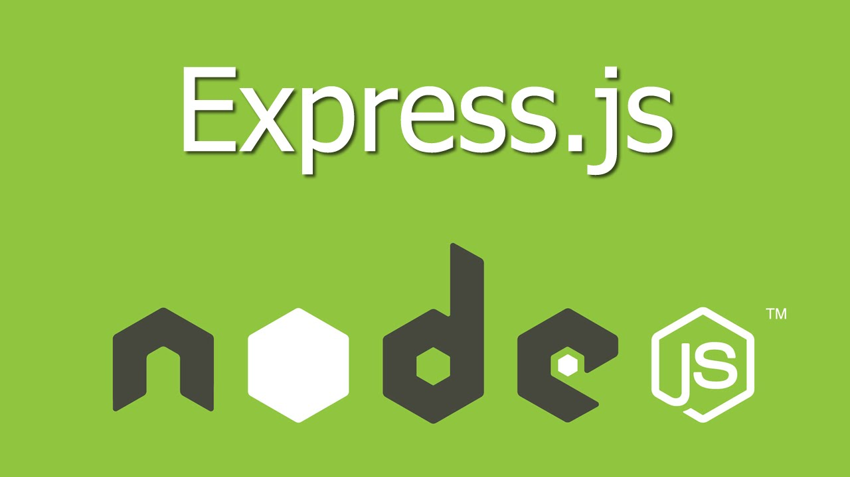
ExpressJS (back-end web framework)
A server-side JavaScript framework.
Express JS is a Node.js framework designed to build API's web applications cross-platform mobile apps quickly and make node js easy.
It's a layer built on the top of the Node js that helps manage servers and routes.

Slide 6

Angular (front-end framework)
Client-side framework.
Used to build the front end for a MEAN application.
Angular by writing in TypeScript,
Many single-page web apps are built using Angular on the front end.

Slide 7


REACT (Frontend Library)
React is a JavaScript library created by Facebook
It is a User Interface (UI) library
React is a tool for building UI components

Slide 8
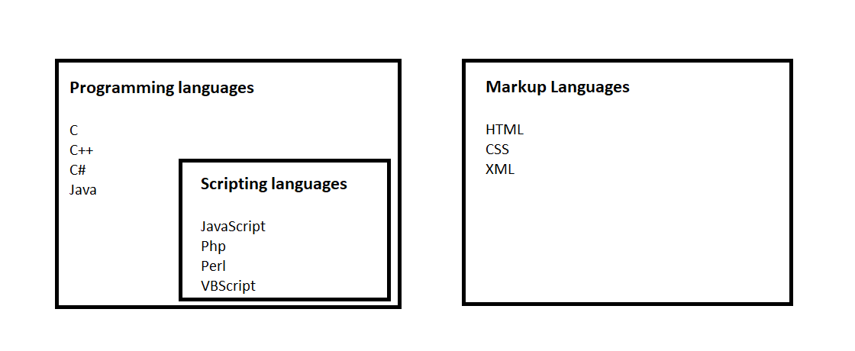
Computer Languages

Slide 9
Programming language
It is a set of instructions or code which tells a computer what it needs to do.
It is provide a logic or instruction to the computer to perform some task to get the desired output from it.
Eg: Java, C, C++, C#, python, JS
Examples

Slide 10
Scripting Language
Scripting languages are basically the subcategory of programming languages
Which is used to give guidance to another program or we can say to control another program so it also involves instructions.
It basically connects one language to one another languages and doesn’t work standalone.
Eg: JavaScript, PHP, Perl, Python,

Slide 11
MARKUP LANGUAGE
Markup languages prepare a structure for the data or prepare the look or design of a page.
These are presentational languages and it does not include any kind of logic or algorithm.
Eg:HTML, XML, XHTML etc.

Slide 12
CODE EDITOR
A code editor is basically a text editor but it is also designed to help you write code.
Eg: vs code editor, sublime, pycharm etc

Slide 13
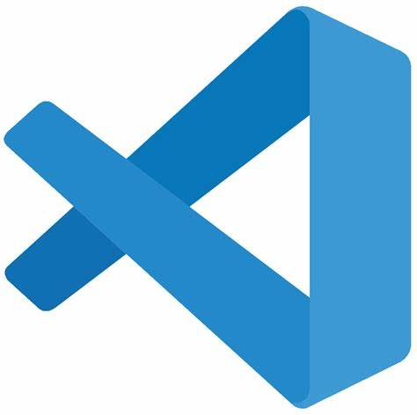
Visual Studio Code
It is a lightweight but powerful source code editor which runs on your desktop and is available for Windows, macOS and Linux.
Download for Windows: https://code.visualstudio.com/Download
Download for Linux: https://snapcraft.io/code

Slide 14
VS Code Extensions
Auto close tag
htmltagwrap
live server
Material icon Theme

Slide 15
HTML (Hyper Text Markup Language)
It is the standard markup language for creating Web pages.
It describes the structure of a Web page
It consists of a series of elements
It's elements tell the browser how to display the content

Slide 16
ELEMENTS
HTML element is defined by a start tag, some content, and an end tag.
<Starting tag> Content goes here... </Ending tag>
Eg: <h1>My First Heading</h1>

Slide 17
TAGS
All HTML tags must enclosed within < > these brackets.
If you have used an open tag <tag>, then you must use a close tag </tag> (except some tags)
<tag> content </tag>
eg:<p> Paragraph Tag </p>

Slide 18
ATTRIBUTE
All HTML elements can have attributes
Attributes provide additional information about elements
Attributes are always specified in the start tag
Attributes usually come in name/value pairs like: name="value“
The <a> tag defines a hyperlink. The href attribute specifies the URL of the page .

Slide 19
UNCLOSED HTML TAG
Some HTML tags are not closed, for example br and hr.
<br> Tag: br stands for break line, it breaks the line of the code.
<hr> Tag: hr stands for Horizontal Rule. This tag is used to put a line across the webpage.

Slide 20
BASIC TAGS
The <!DOCTYPE html> declaration defines that this document is an HTML5 document
<html>-element is the root element of an HTML page
The <head> element contains meta information about the HTML page
The <title> element specifies a title for the HTML page (which is shown in the browser's title bar or in the page's tab)
The <body> element defines the document's body, and is a container for all the visible contents, such as headings, paragraphs, images, hyperlinks, tables, lists, etc.
The <h1> element defines a large heading
The <p> element defines a paragraph

Slide 21
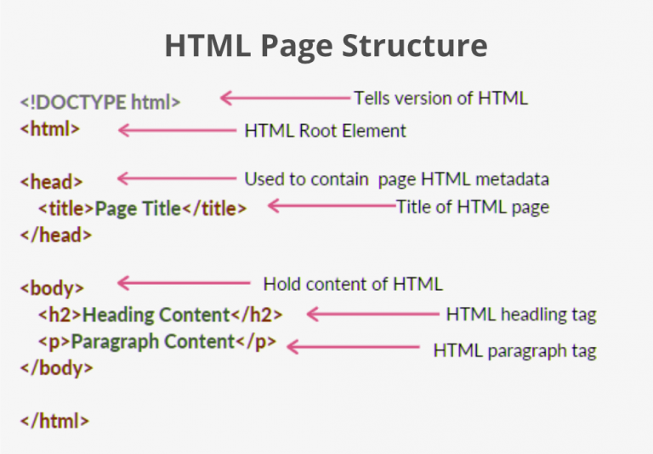

Slide 22
COMMENTING TAG
The comment tag is used to insert comments in the source code.
Comments are not displayed in the browsers.
It enhances the readability
<!--This is a comment. Comments are not displayed in the browser-->
<p>This is a paragraph.</p>
Ctrl+/

Slide 23
TEXT TAGS
Heading - <h1><h1> to <h6></h6>
Paragraph - <p>
<b> and <strong> Tags
<i> and <em> Tags
<pre> Tag
<mark> Tag
<small> Tag - <big> Tag
<sup> Tag
<sub> Tag
<del> Tag

Slide 24
SEMANTIC TAGS
A semantic element clearly describes its meaning to both the browser and the developer.
Eg <form>, <header>, <table>, and <article>

Slide 25
NON-SEMANTIC TAGS
Tells nothing about its content.
Examples of non-semantic elements: <div> and <span>

Slide 26
TASK
1 List out the features of HTML 5
2 Difference between html and html5
3 What is formatting in HTML?
4 What is the difference between HTML elements and tags?
5 How can you make text appear in a monospace font in HTML?

Slide 27
Thank You 😊

